Slide 1
Data Analytics
Project 1

Slide 2
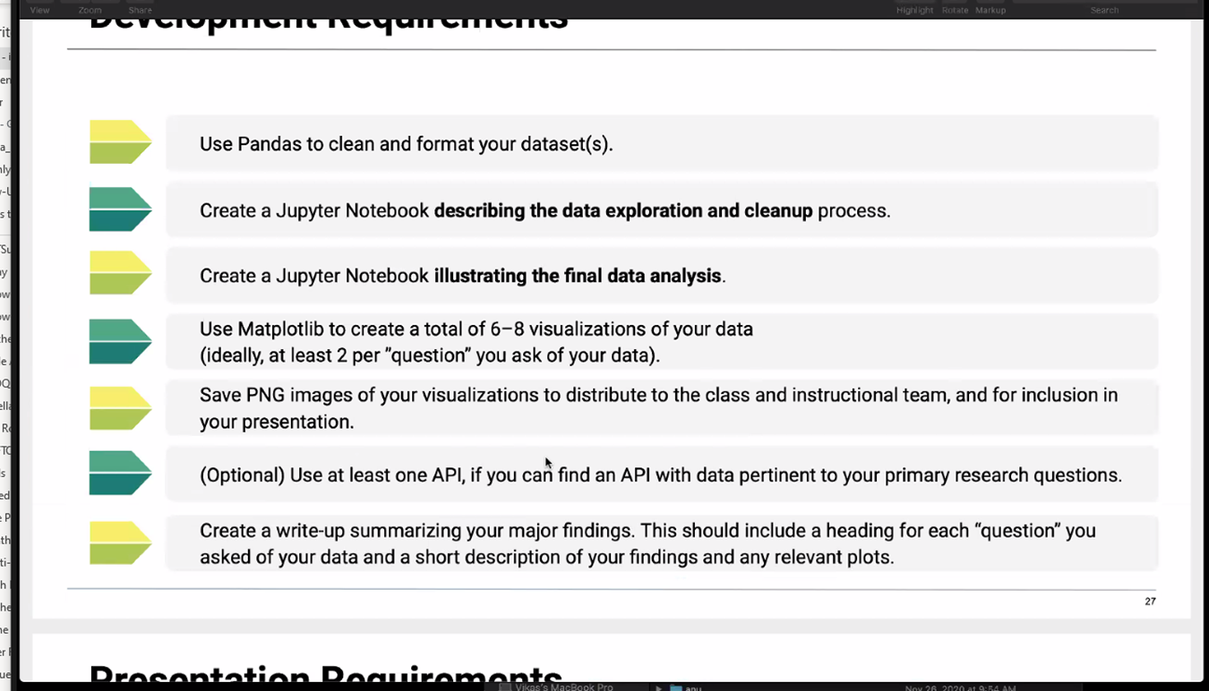
Development Requirements

Slide 3
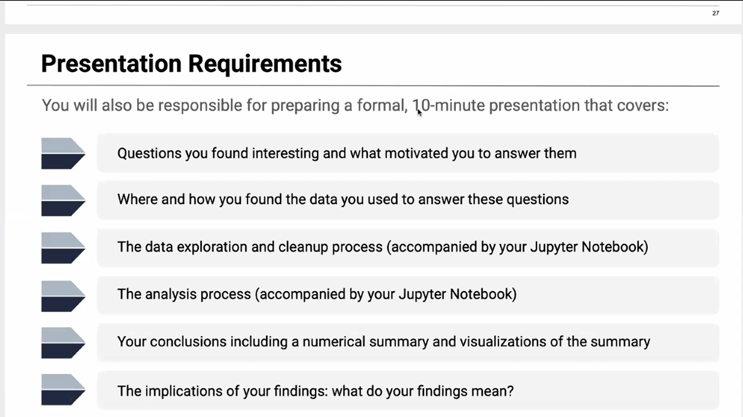

Slide 4
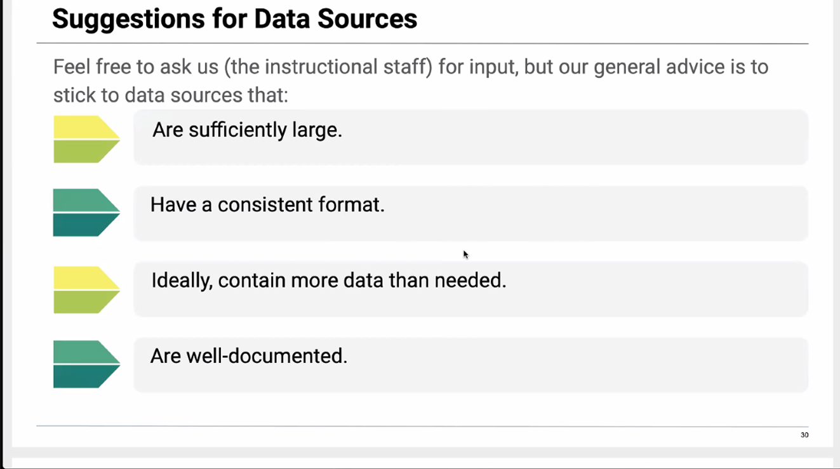

Slide 5
